Slide 1
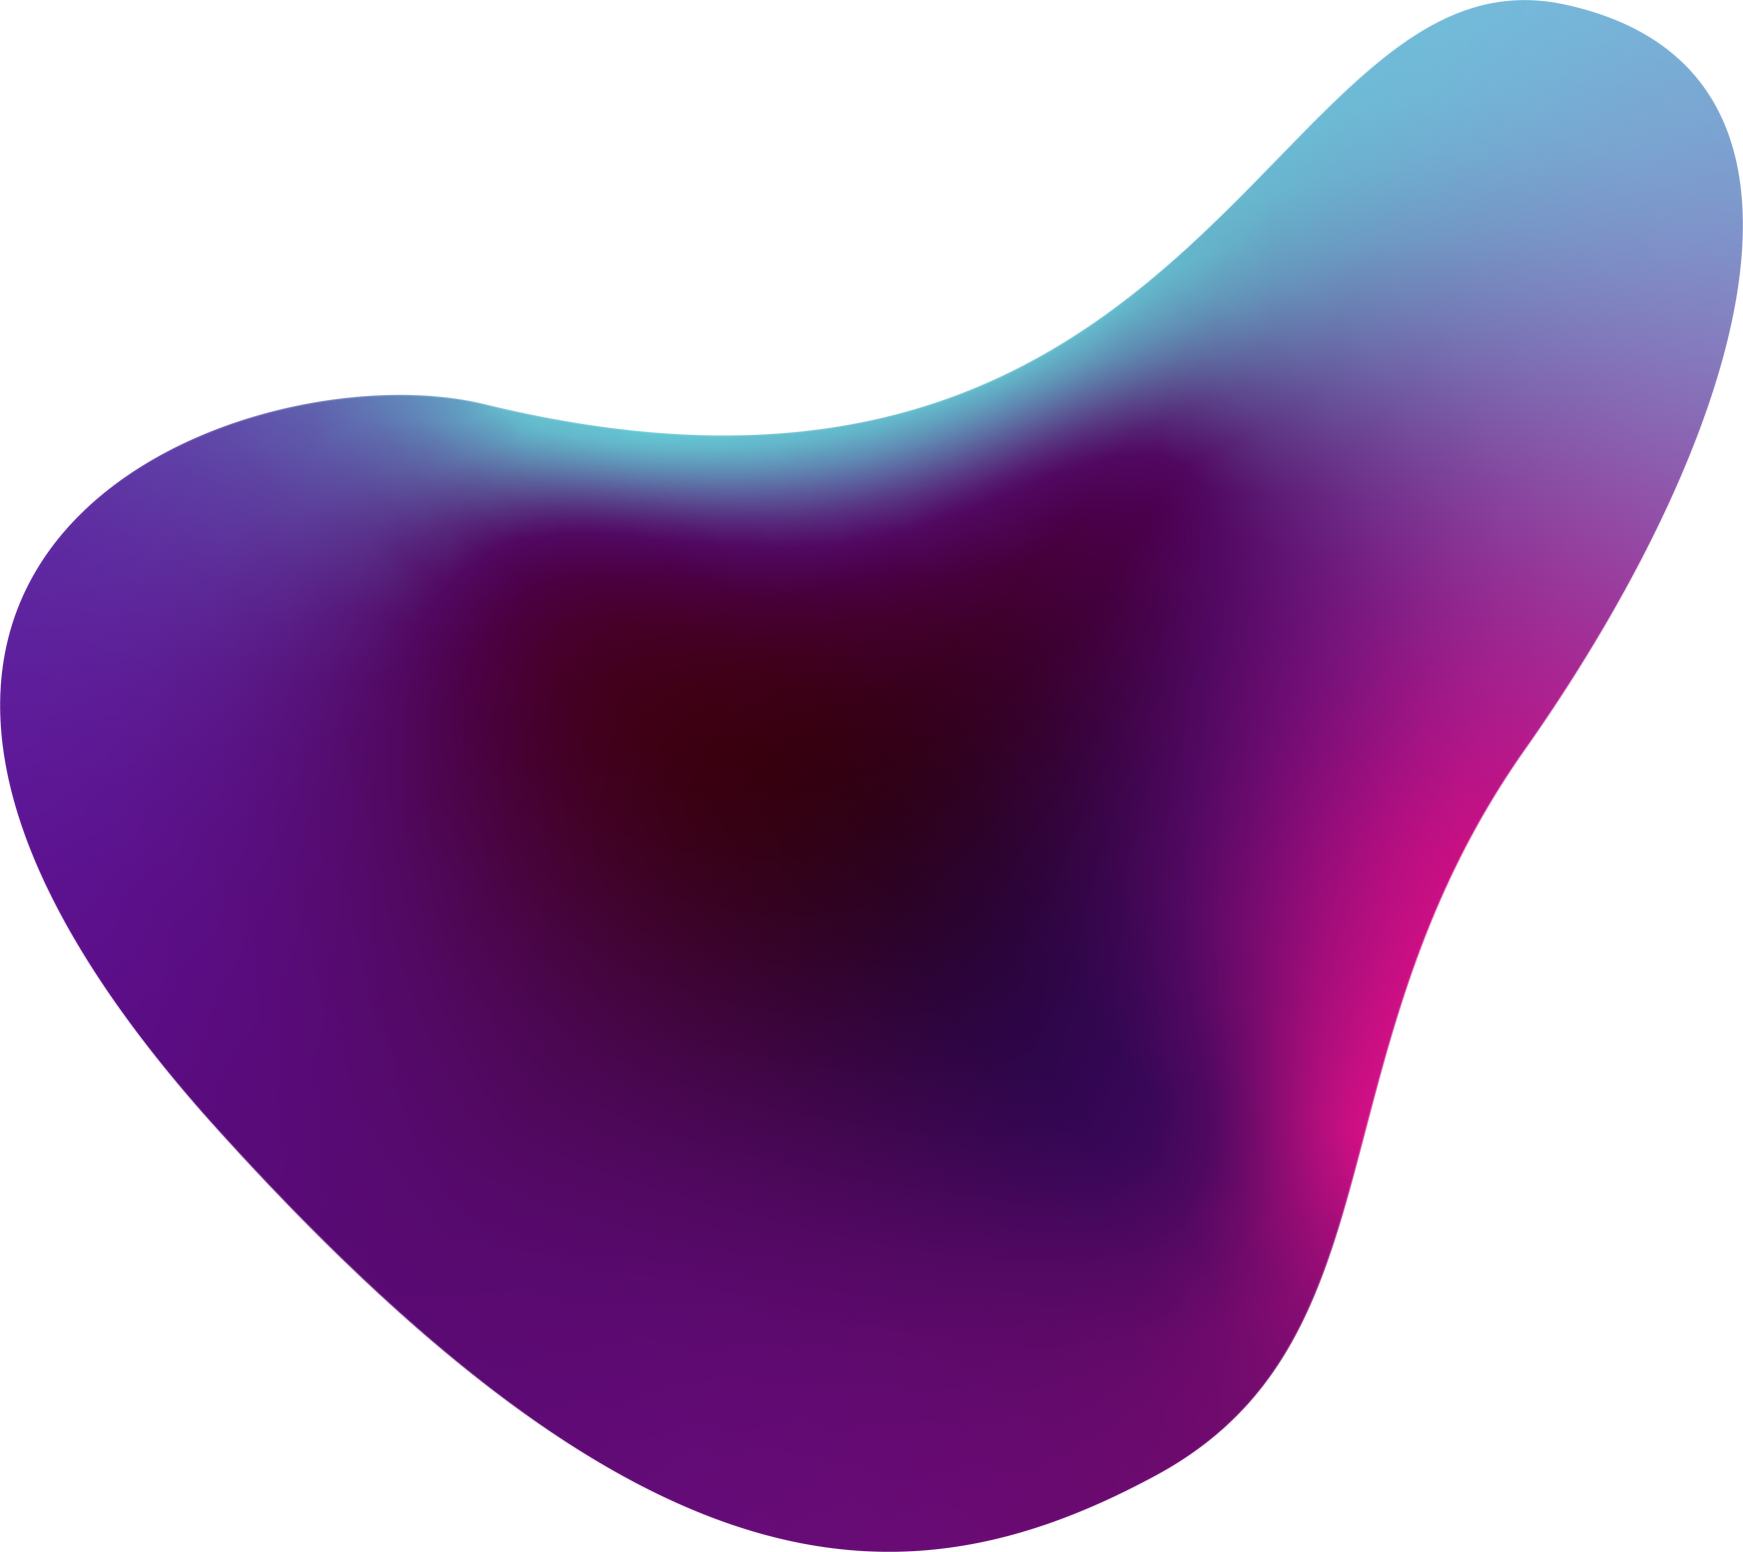

CHATBOT FOR HEALTH AWARENESS
Mentor : Dr.Y.SriLalitha
Vanimireddy Ram Teja(19241A1257)
Sridhar Reddy Eguram(19241A05V1)
Nenavath Anil Nayak(19241A1237)
G.T.Srinivasa Rao(18241A1220)

Slide 2
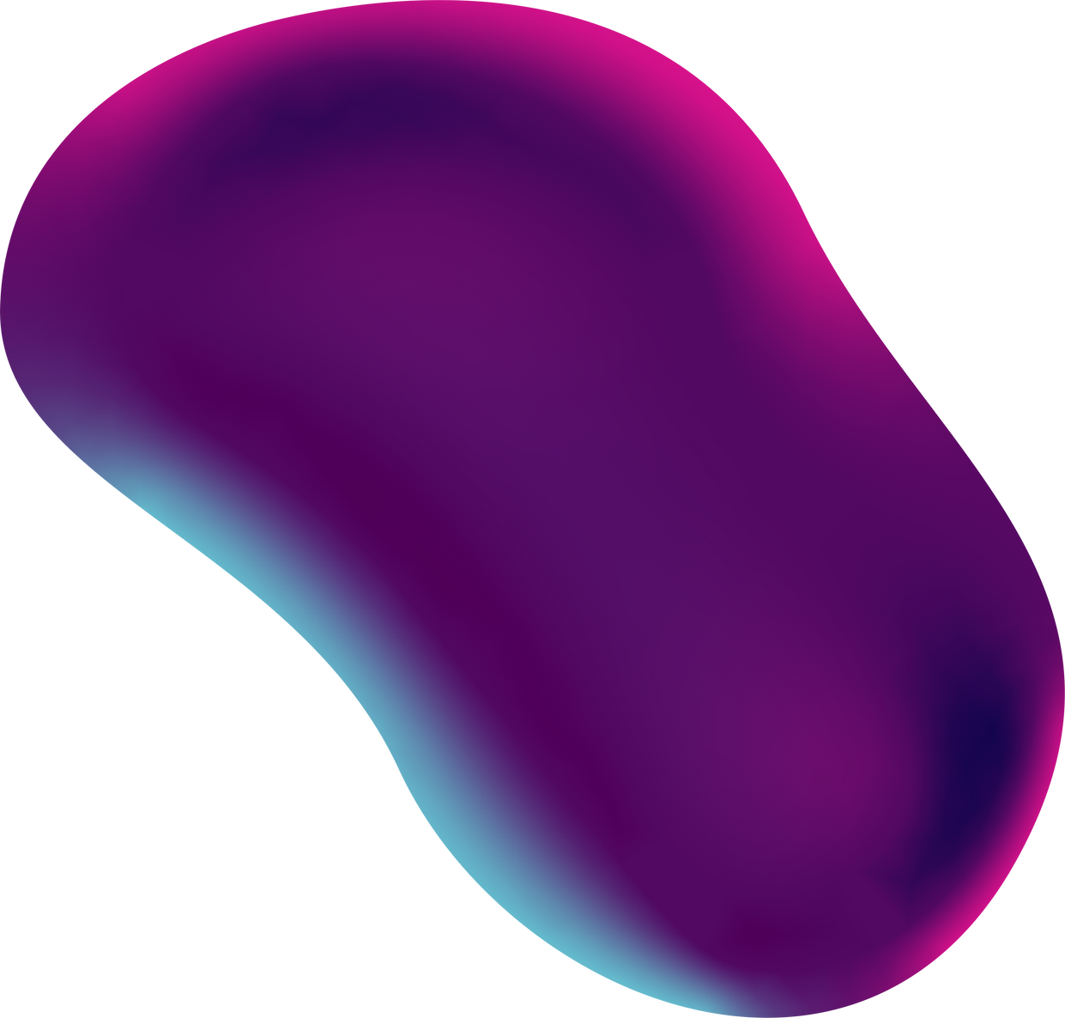
ABSTRACT OF THE PROJECT

Slide 3
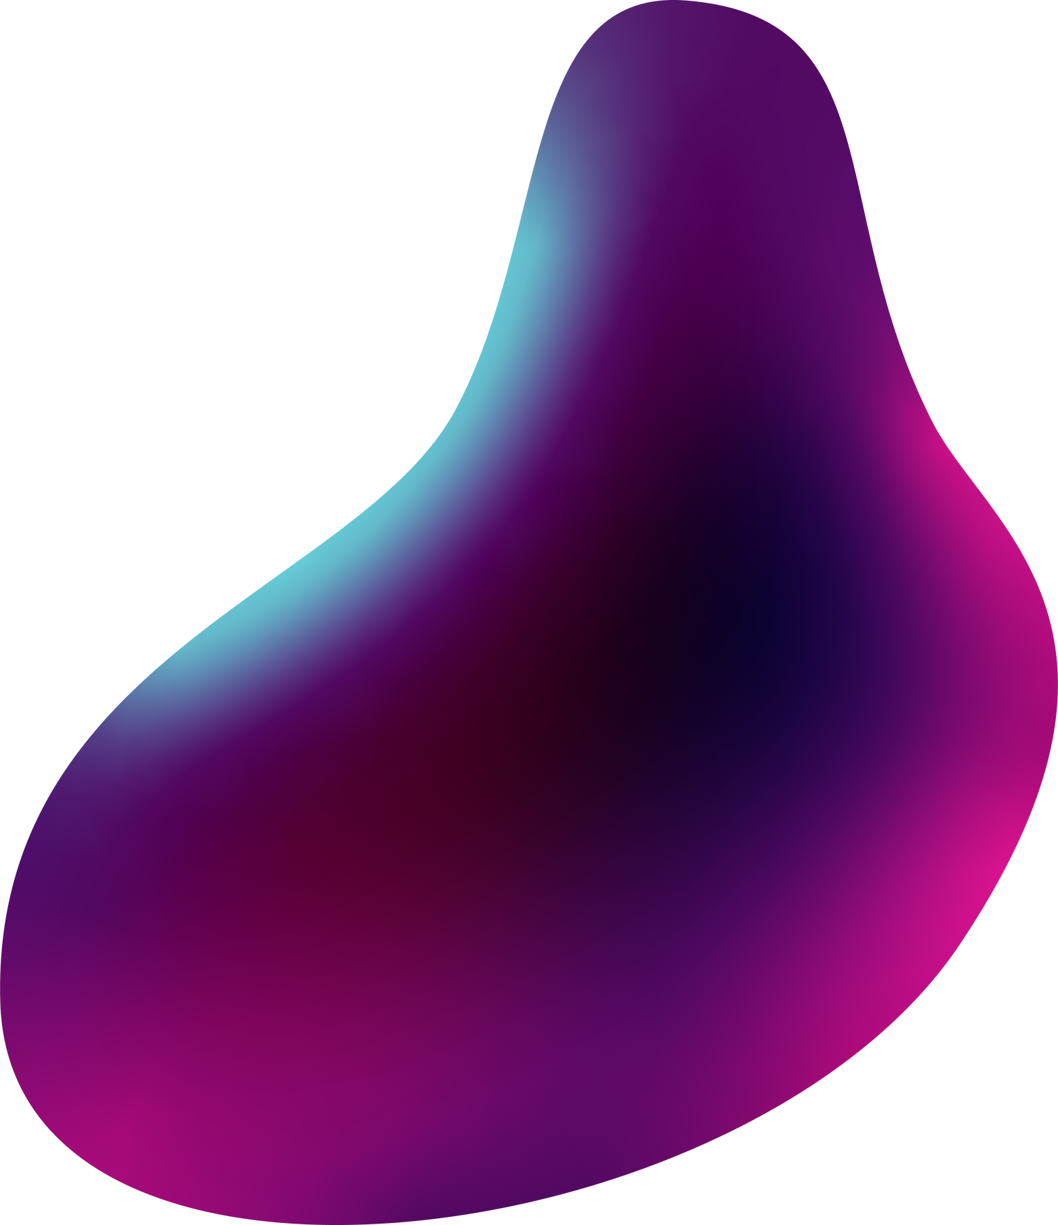
AI-powered chatbots can be used to triage patients and guide them to receive the appropriate help. Chatbots are considered a more reliable and accurate alternative to online searches
Healthcare is very important to lead a good life. However, it is very difficult to obtain a consultation with the doctor nowadays. The idea is to create a medical chatbot using Artificial Intelligence that can tell the patient which doctor specialised in which field. Our chatbot takes symptoms as input from the patient and predicts the type of disease the user may have and recommends the doctor in that field. Our chatbot knows every nook and corner of the hospital which helps the patients to easily access those areas.
The chatbot stores the data in the database to identify the sentence keywords and to make a query decision and answer the question. Ranking and sentence similarity calculation is performed using n-gram, TFIDF and cosine similarity. The score will be obtained for each sentence from the given input sentence and more similar sentences will be obtained for the query given.

Slide 4
SCOPE OF THE PROJECT

Slide 5
Our Aim of the project is to take symptoms as input from the user and predict what type of disease the user may have
For this we have use sequential model to extract the symptoms from the text and KNN algorithm for predicting the type of disease
It tells what disease the user may have from given symptoms
Our chatbot also recommends doctor in that feild.

Slide 6
INTRODUCTION

Slide 7
What is
Retrieval Based Chatbot?
Retrieval-based chatbots work on the principle of graphs or directed flows. The chatbot is trained to provide the best possible response from a database of predefined responses. The responses are based on existing information.
Retrieval-based chatbots use techniques like keywords matching, machine learning or deep learning to identify the most appropriate response. Regardless of the technique, these chatbots provide only predefined responses and do not generate new output.

Slide 8
Few Limitations :
This type of chatbot will not generate new responses if the user may ask question out of our database our chatbot will returns inbuilt response
This form of chatbot needs a large database.

Slide 9
System Architecture:

Slide 10
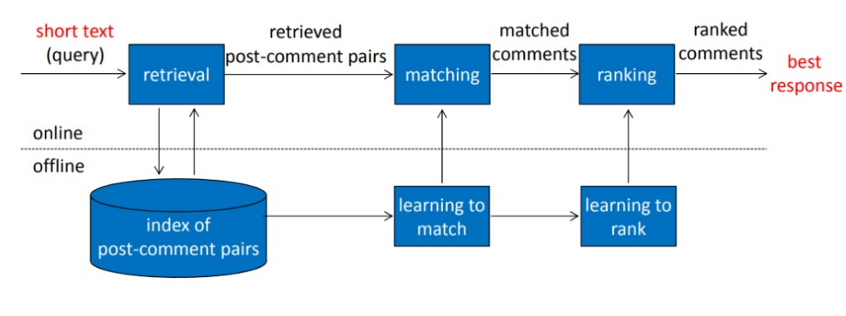
System Architecture of retrieval-based short text conversation

Slide 11
Software Requirements

Slide 12
Language :Python version 3.7
Source :Dataset from kaggle, Github
IDE : Google Collab/Jupyter Notebook
HardWare Requirements :
Operating System : Windows 7,Mac, Linux
Processor : intel core i3 or above
Hard disk : 512 GB or above
RAM : 4GB or above

Slide 13
UML Diagrams

Slide 14
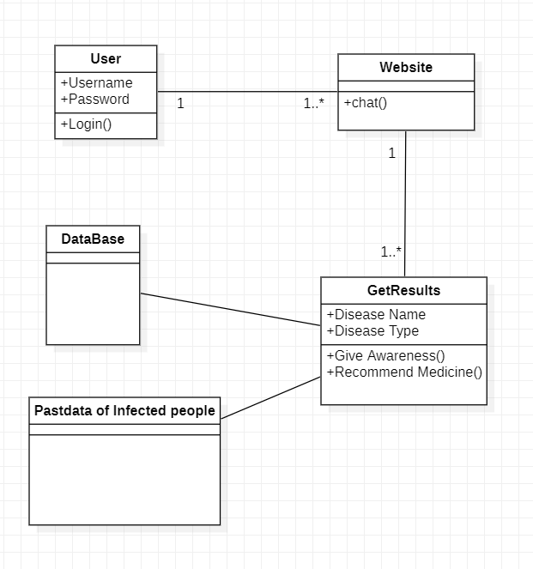
Class Diagram

Slide 15
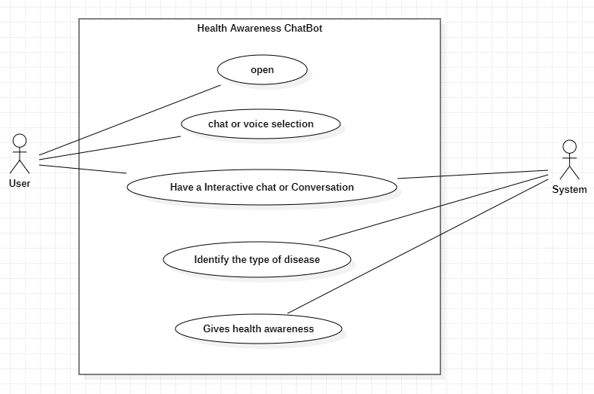
Use Case Diagram

Slide 16
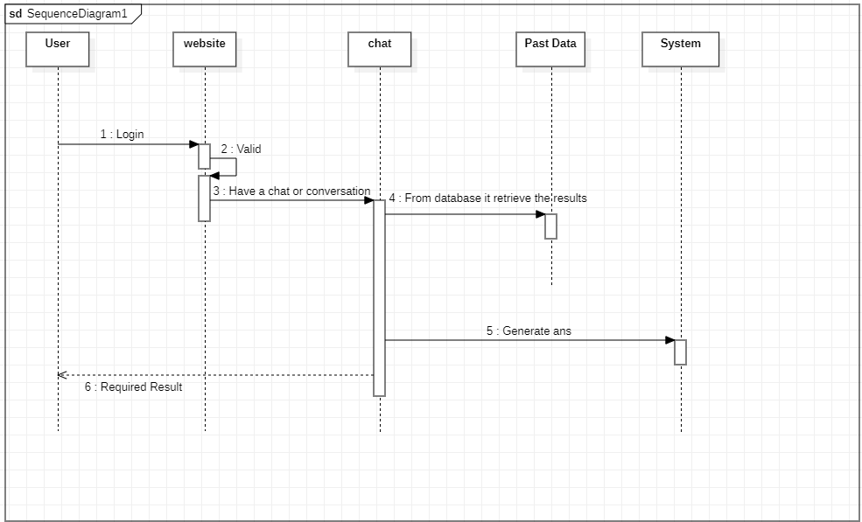
Sequence Diagram

Slide 17
Implementation

Slide 18
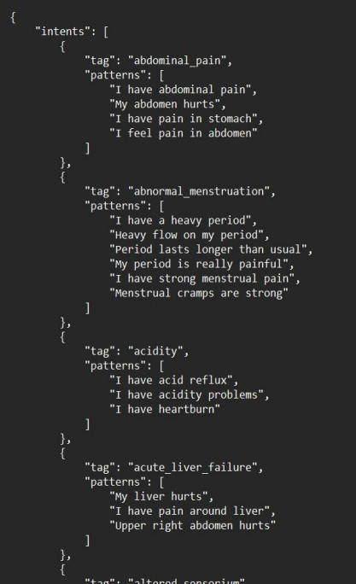
DATASET

Slide 19
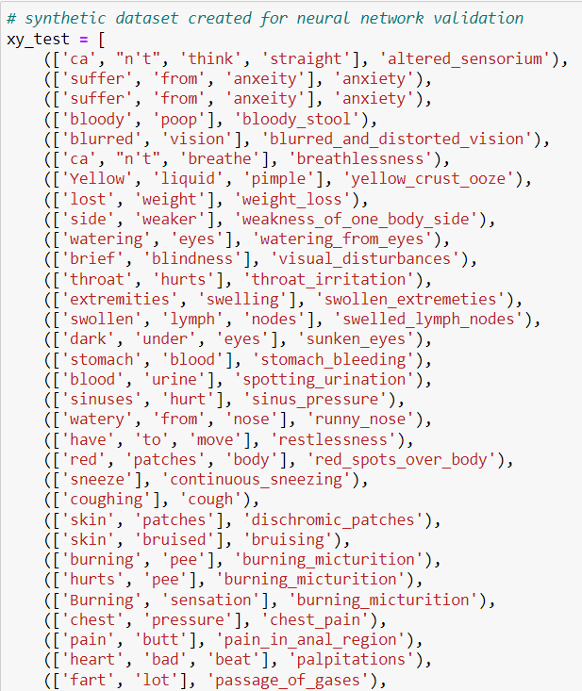
TestSet Composition

Slide 20
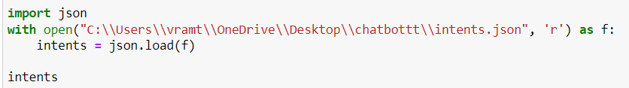
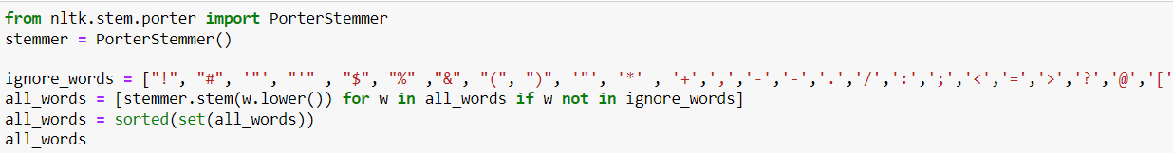
Sample code for chatbot:
Loading the dataset
Preprocessing the Dataset

Slide 21
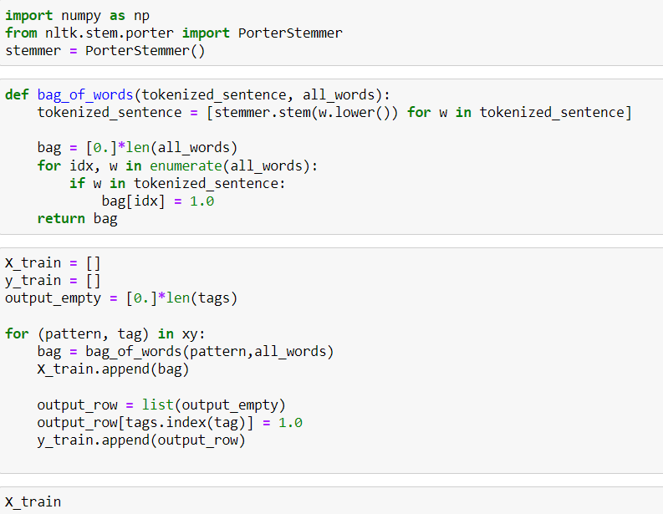

Slide 22
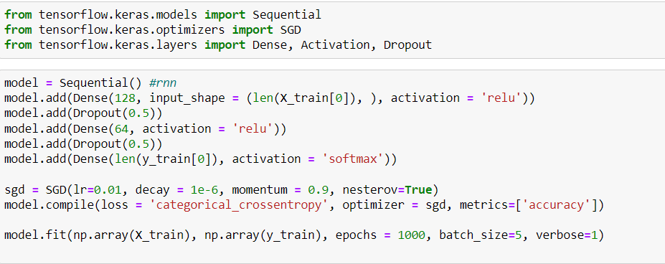
Train the model:

Slide 23
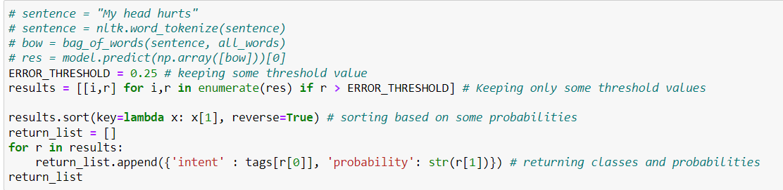
Predicting the Result:

Slide 24
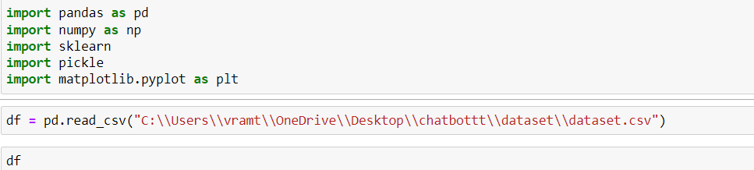
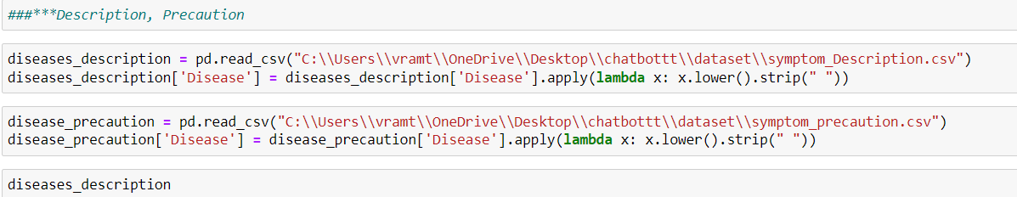
Code for disease Prediction:
Loading dataset

Slide 25
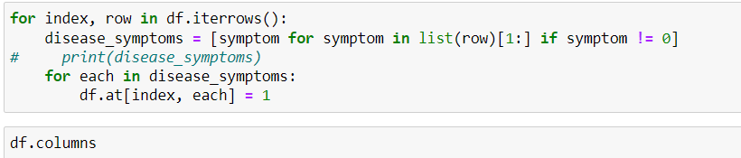
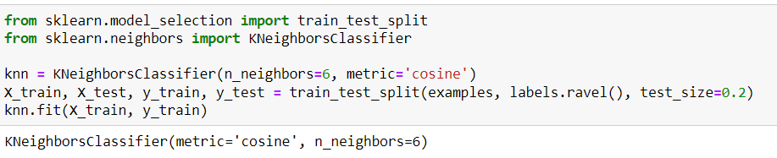
Transforming the dataset
Training the model

Slide 26
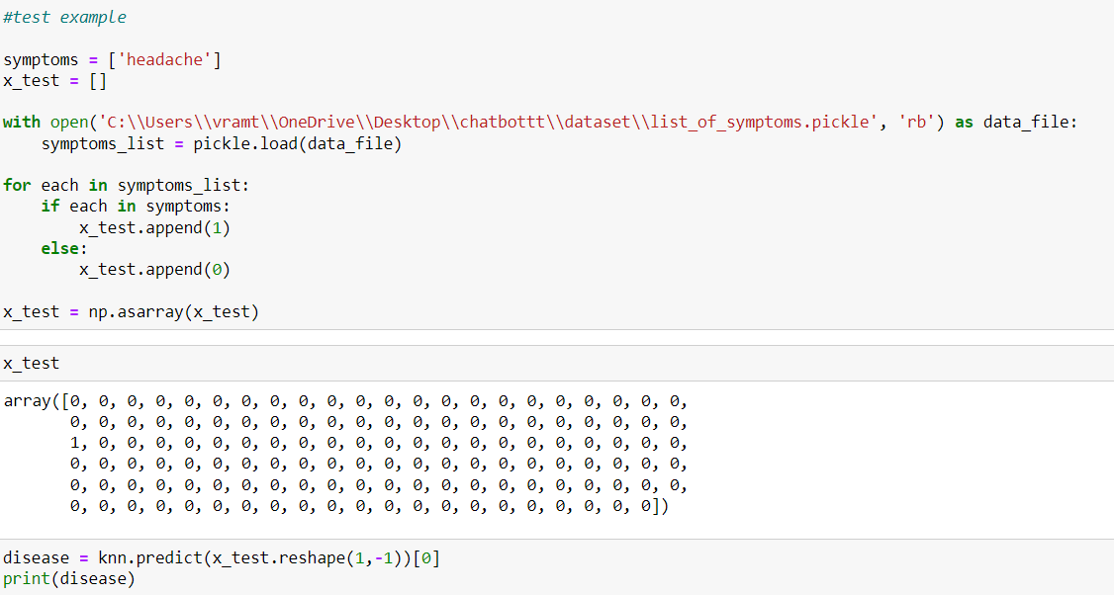
Predicting the disease

Slide 27
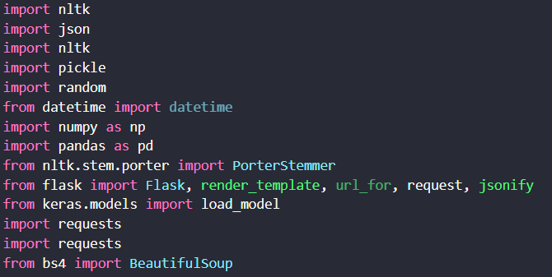
Final Code
Loading the packages

Slide 28
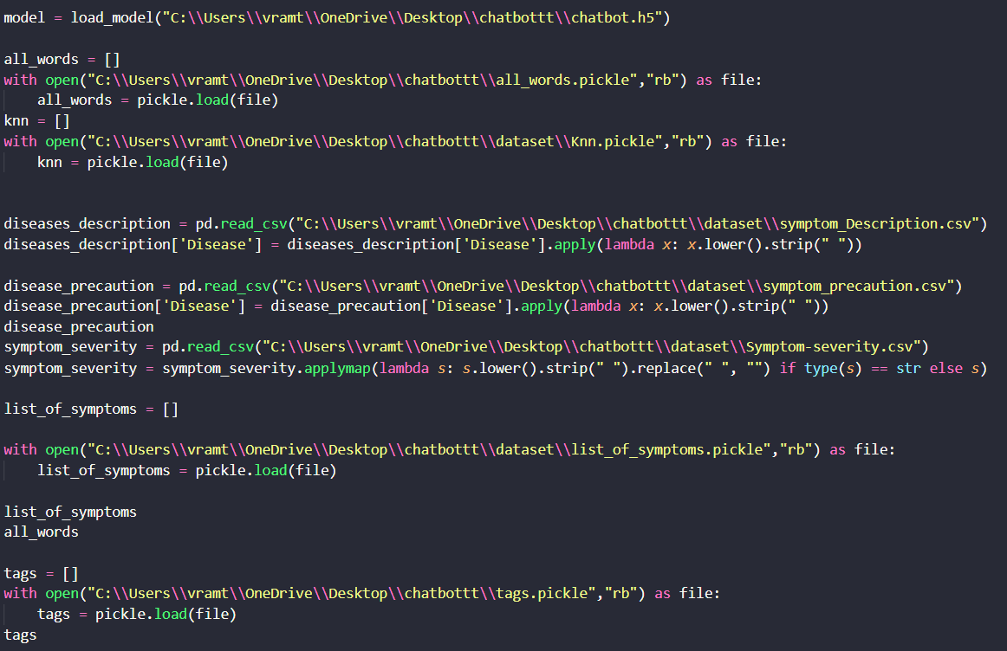
Loading the Model and Dataset

Slide 29
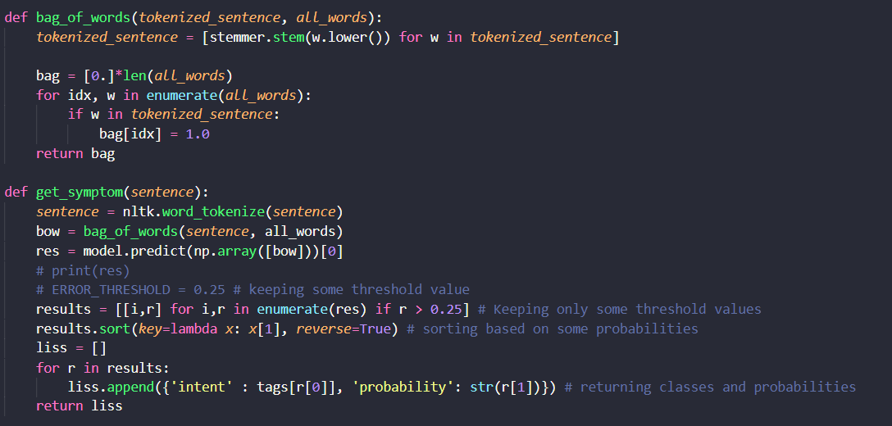
Preprocessing the text:

Slide 30
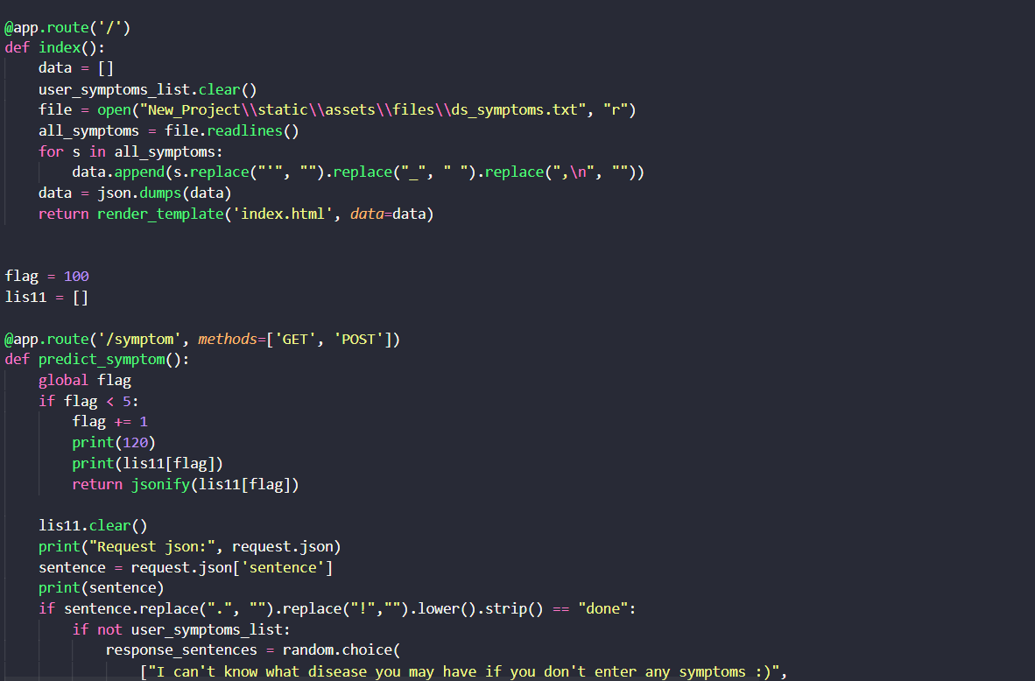
Deploying the Model in Website:

Slide 31
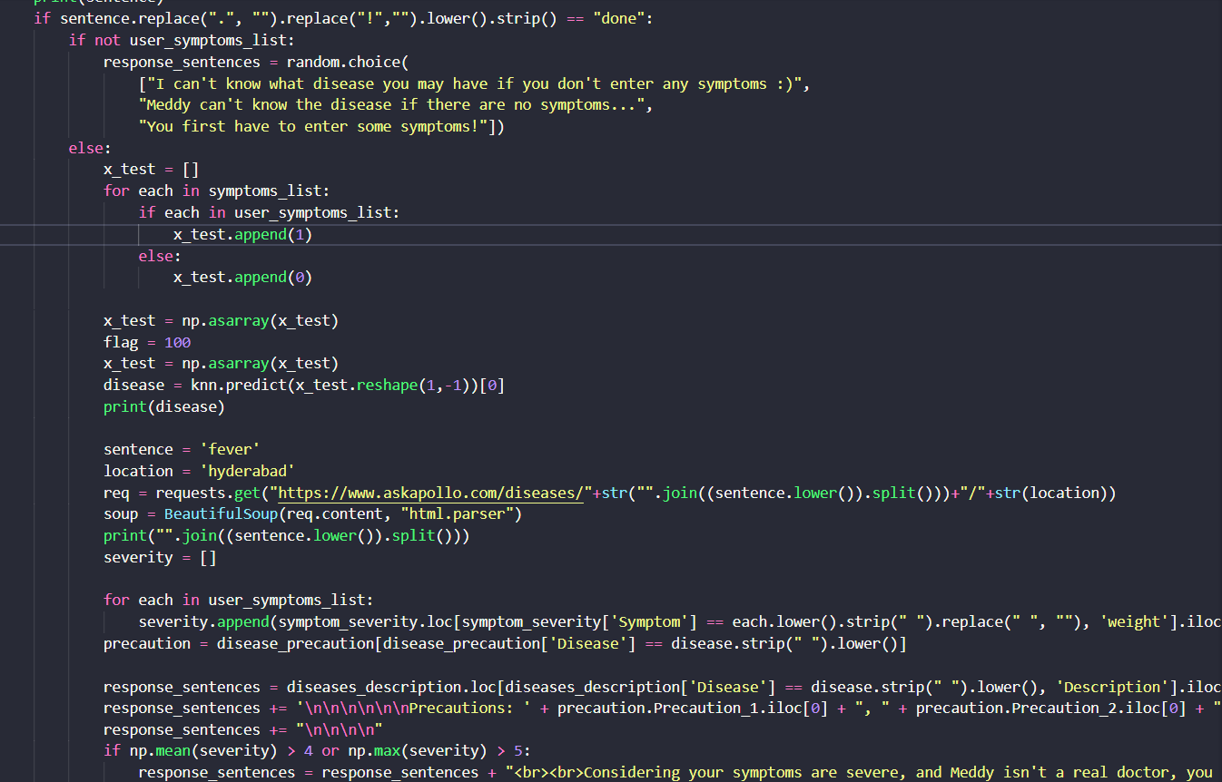

Slide 32
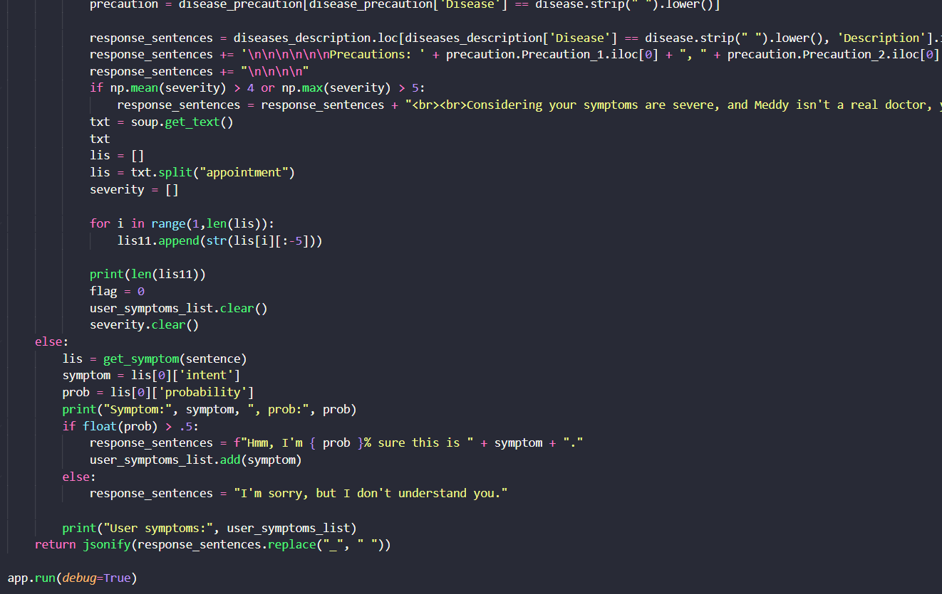

Slide 33
Output

Slide 34
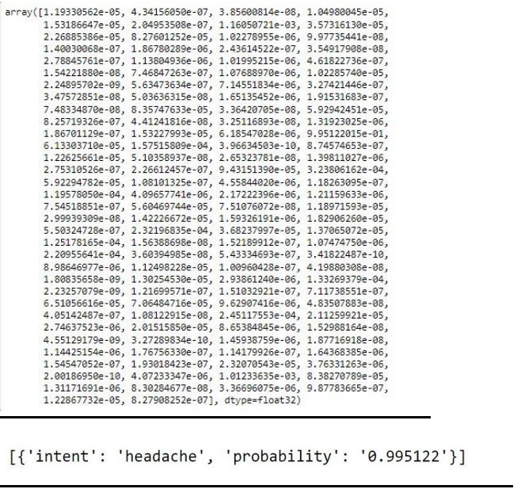
For Chatbot

Slide 35
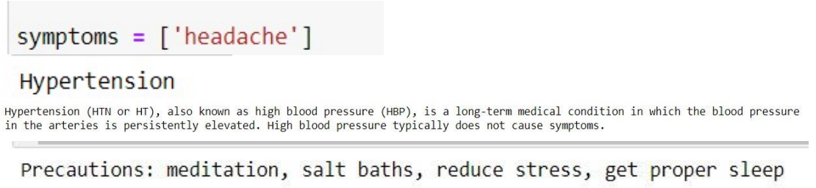
Disease Prediction

Slide 36
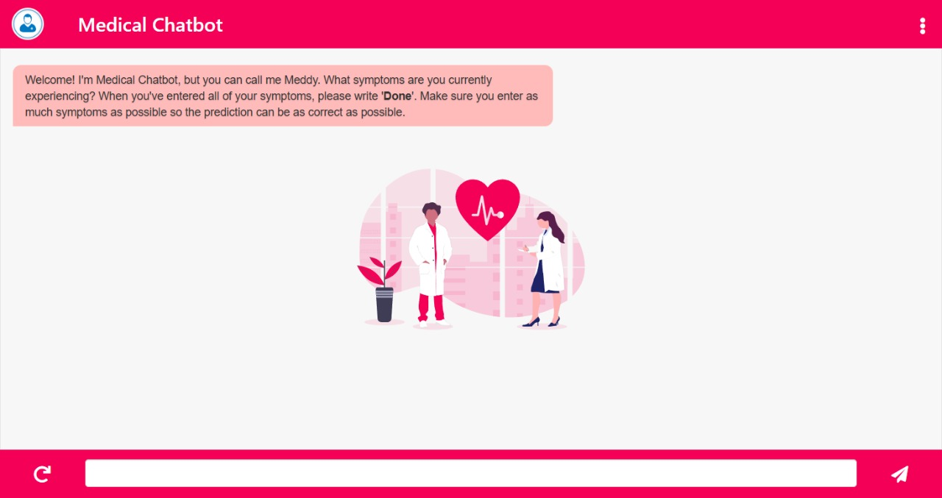
User needs to enter the Smptoms in web

Slide 37
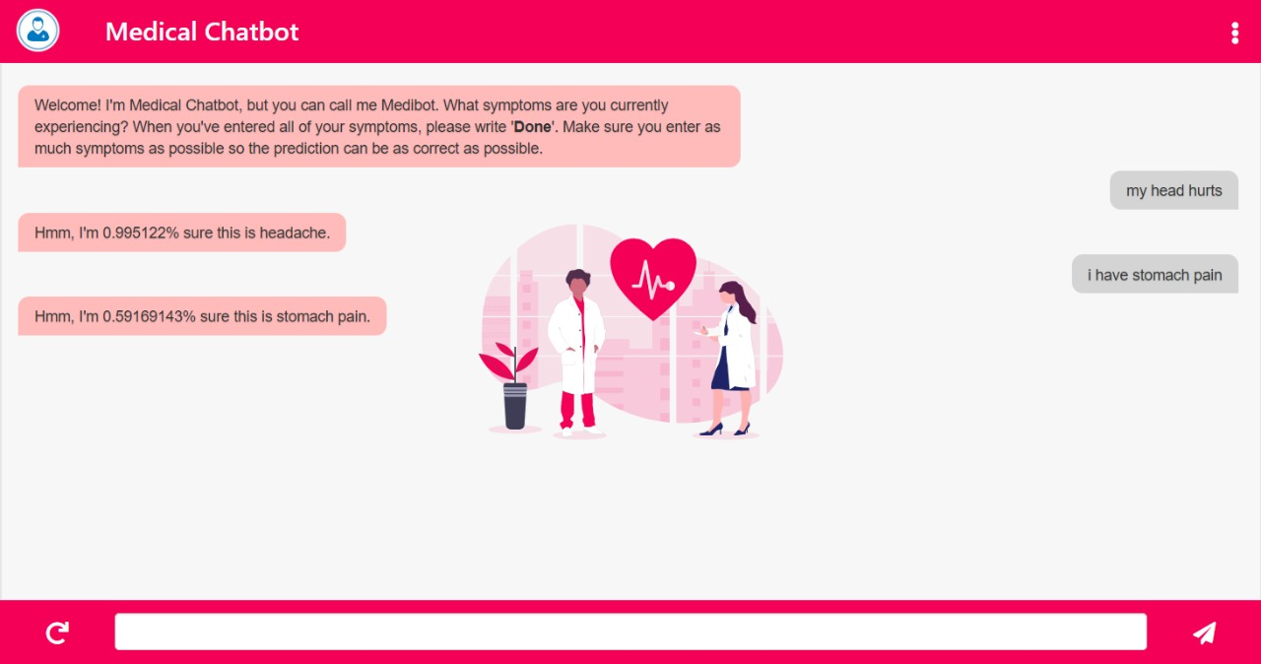

Slide 38
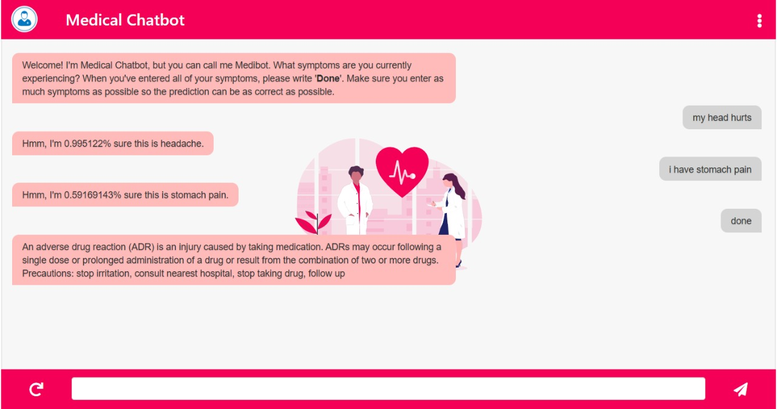

Slide 39
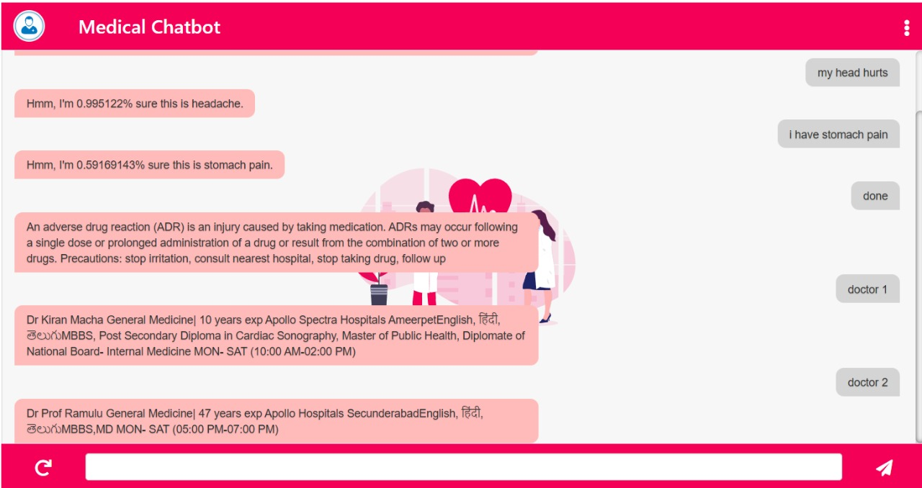

Slide 40


